Slide 1
Chapter 7
Target Code Generation

Slide 2
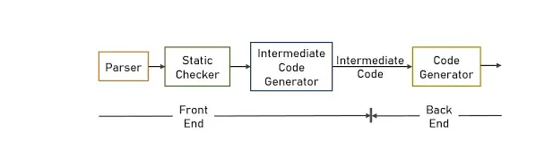
Code Generator
There are 2 main code generator:
1] Intermediate Code Generator ( see chapter 5)
2] Target Code Generator

Slide 3
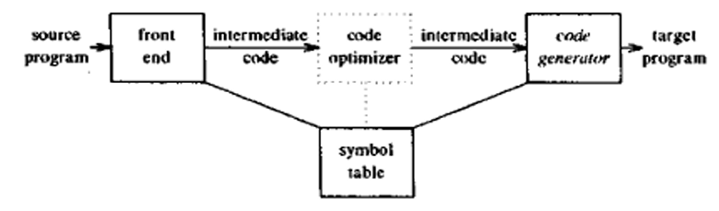
Target Code generation
is the final phase in compiler model. It takes as input an intermediate representation of the source program and produces as output an equivalent target program.
The code generation techniques can be used whether or not an optimizing phase occurs before code generation.

Slide 4
Target Code generation
The main purpose of the Target Code Generator is to write a code that the machine can understand and also register allocation, instruction selection, etc. The output is dependent on the type of assembler.
This is the final stage of compilation. The optimized code is converted into relocatable machine code which then forms the input to the linker and loader.

Slide 5
Target Code generation
The code generated by the compiler is an object code of some lower-level programming language, for example, assembly language.
The source code written in a higher-level language is transformed into a lower-level language that results in a lower-level object code, which should have the following minimum properties:
It should carry the exact meaning of the source code.
It should be efficient in terms of CPU usage and memory management.

Slide 6
Register Allocations in Code Generation
Computations are generally assumed to be performed on high-speed memory locations, known as registers.
Performing various operations on registers is efficient as registers are faster than cache memory.
This feature is effectively used by compilers. However, registers are not available in large amount and they are costly. Therefore, we should try to use minimum number of registers to incur overall low cost.

Slide 7
Register Allocations in Code Generation
Register allocation is an important method in the final phase of the compiler. It maps an unlimited namespace onto that register set of the target machine..

Slide 8
Generating Code for Statement
Example 1:- Consider the three-address statement x = 5 + 3 * 2
Three-Address Code (TAC)
Generated Assembly Code
t1 = 3 * 2
t2 = 5 + t1
x = t2
MOV R1, #3 ; Load 3 into R1
MOV R2, #2 ; Load 2 into R2
MUL R3, R1, R2 ; Multiply R1 and R2, store result in R3
MOV R4, #5 ; Load 5 into R4
ADD R5, R4, R3 ; Add R4 and R3, store result in R5
MOV x, R5 ; Assign R5 to x
Optimized TAC
t1 = 3 * 2
x = 5 + t1

Slide 9
Generating Code for Statement
Example 2:- Consider the three-address statement x:= y + z. It can have the following sequence of codes:
MOV y,R0 /* load y into register R0 */
ADD z,R0 /* add z to R0 */
MOV R0,x /* store R0 into x */

Slide 10
Generating Code for Statement
Example 3:-
The statement d:= (a-b) + (a-c) + (a-c)

Slide 11
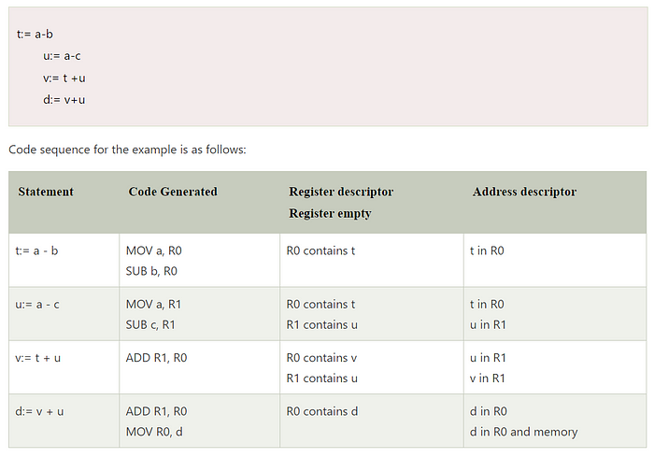
The statement d:= (a-b) + (a-c) + (a-c)

Slide 12
CONCLUSION
In computing, code generation is part of the process chain of a compiler and converts intermediate representation of source code into a form (e.g., machine code) that can be readily executed by the target system.
The code generator within a compiler is responsible for converting intermediate code to target code.
Code generation can be considered as the final phase of compilation.
The code generated by the compiler is an object code of some lower-level programming language, for example, assembly language.

Slide 13
Full Flow Summary
Lexical Analysis: Convert source code to tokens.
Syntax Analysis: Generate a parse tree .
Semantic Analysis: Ensure semantic correctness.
Intermediate Code Generation: Convert to TAC or IR.
Optimization: Simplify or optimize TAC.
Code Generation: Emit machine/assembly code.

Slide 14
Additional examples
The provided assignment statement w:=(x−y)+(x−z)+(x−z) can be represented as a sequence of three-address codes in a queue:
The corresponding code sequence for the given problem is expressed as:
TAC: a := x - y
b := x - z
c := a + b
w := b + c

Slide 15
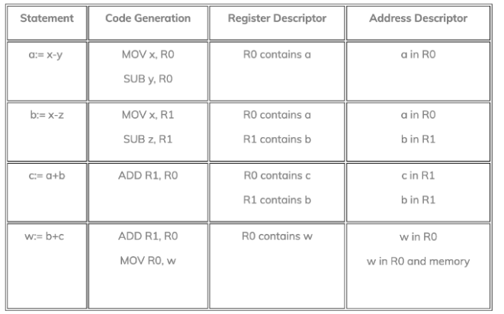
Additional examples w:=(x−y)+(x−z)+(x−z)

Slide 16
Additional examples w:=(x−y)+(x−z)+(x−z)
Code Generation:
For a := x - y, it generates the assembly-like code MOV x, R0 (moves the value of x to register R0) and SUB y, R0 (subtracts the value of y from the content of R0).
For b := x - z, it generates MOV x, R1 and SUB z, R1.
For c := a + b, it generates ADD R1, R0 (adds the content of R1 to the content of R0).
For w := b + c, it generates ADD R1, R0 and MOV R0, w.
Register Descriptor:
After a := x - y, R0 contains the value of a.
After b := x - z, R1 contains the value of b.
After c := a + b, R0 contains the value of c.
After w := b + c, R0 contains the value of w.
Address Descriptor:
For each assignment, it indicates that the values are directly stored in registers (R0, R1).

